Slide 1
Sensors and Servo motors
Robotics 360

Slide 2
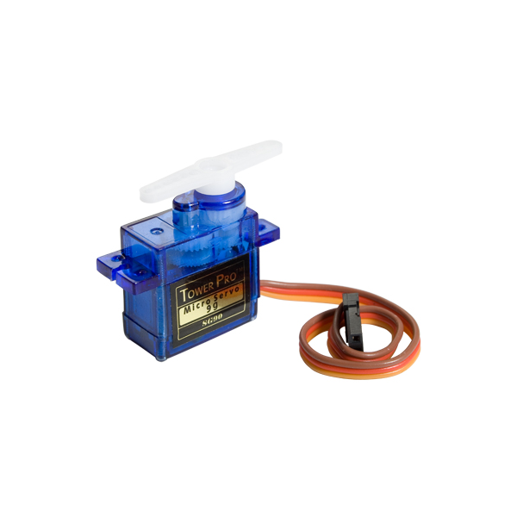
Objective
Create a program where a servo motor activates if a sensor senses a objective at a certain distance.

Slide 3
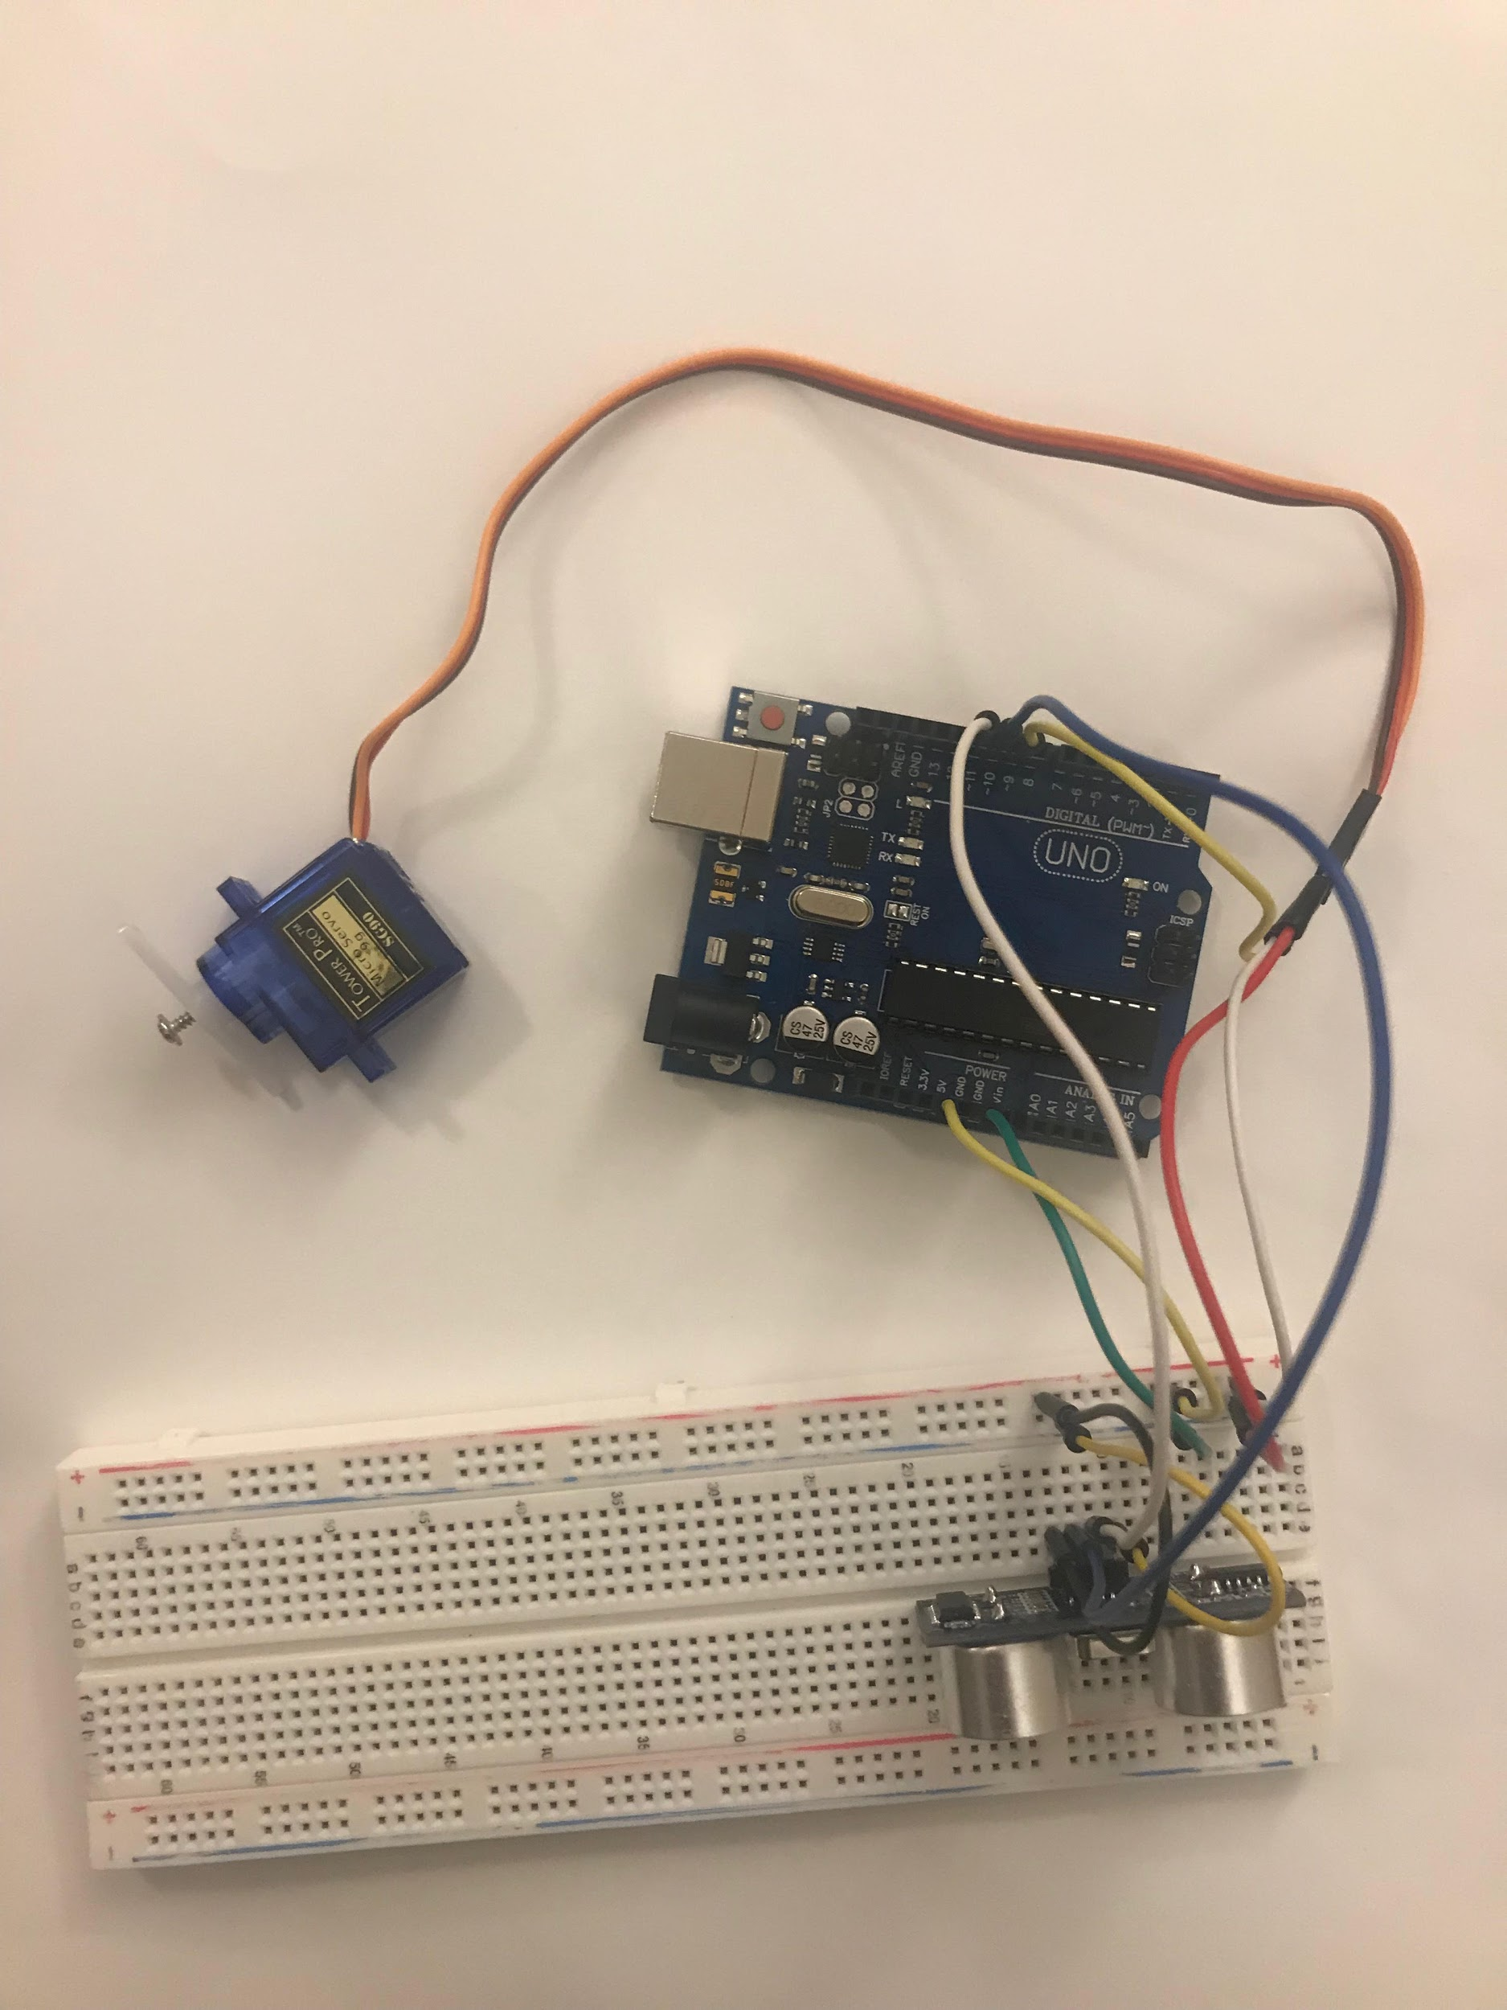
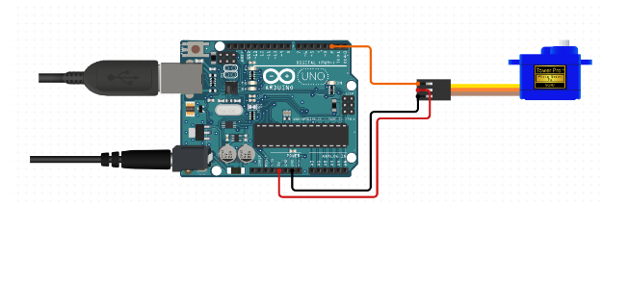
Arduino - Board
Follow the demonstration!

Slide 4
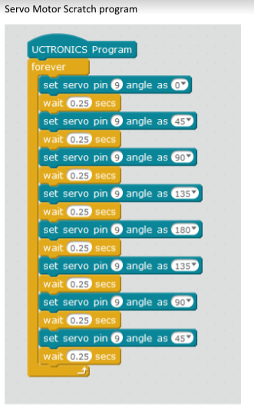
Arduino- Programming
Set servo pin- sets the angle of the servo motor

Slide 5
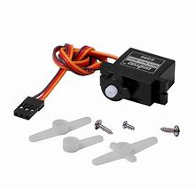
What is a Servo motor?
A motor that accounts for precise control of angular or linear position, velocity and acceleration.
For more information about the servo motor, click here and watch the video.

Slide 6
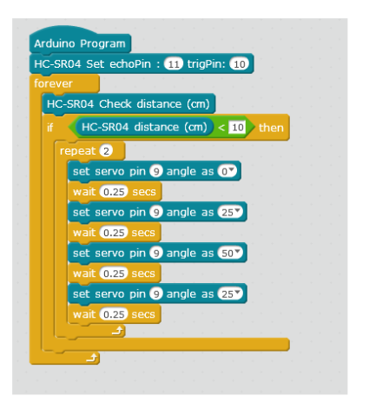
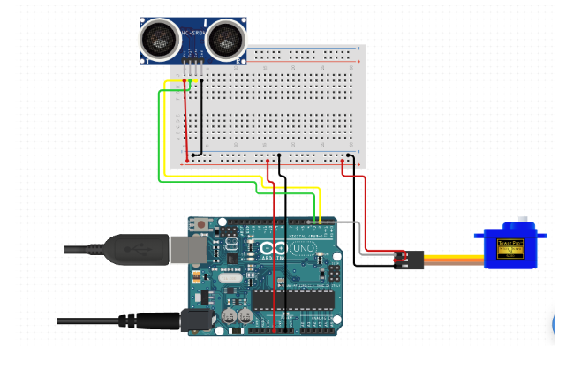
Servo Motor and Sensor

